Slide 1
Hotel Performance Analytics
A Power BI dashboard tracking hotel KPIs across a 540-room property:
Real-time occupancy, ADR, and RevPAR
Forecasted arrivals, stayovers, and departures
Dynamic 7-day forecast visual with room type split
Metrics compared to Target, Last Year, and Last Month
Clean UX using new Power BI card visuals with in-line benchmarking

Slide 2
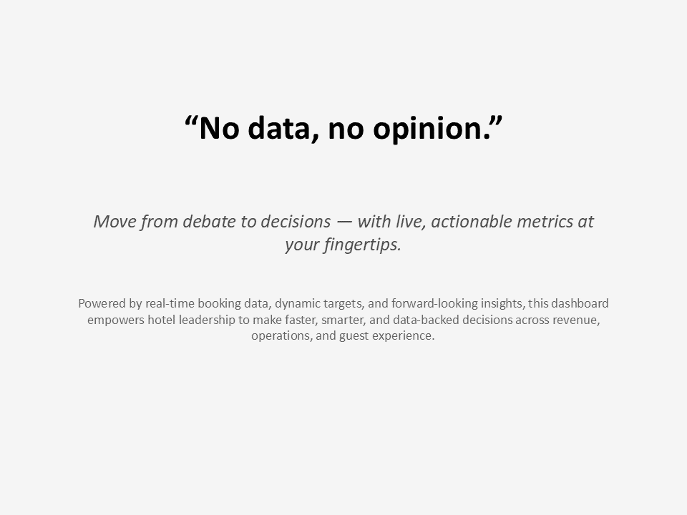

Slide 3
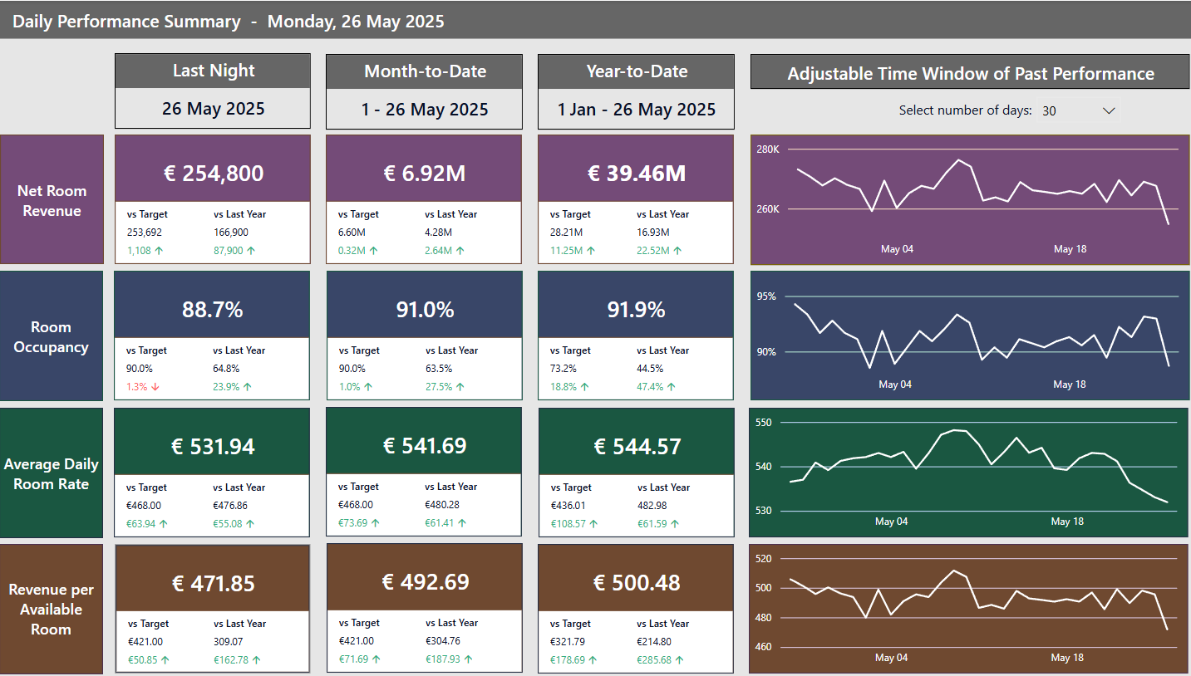

Slide 4
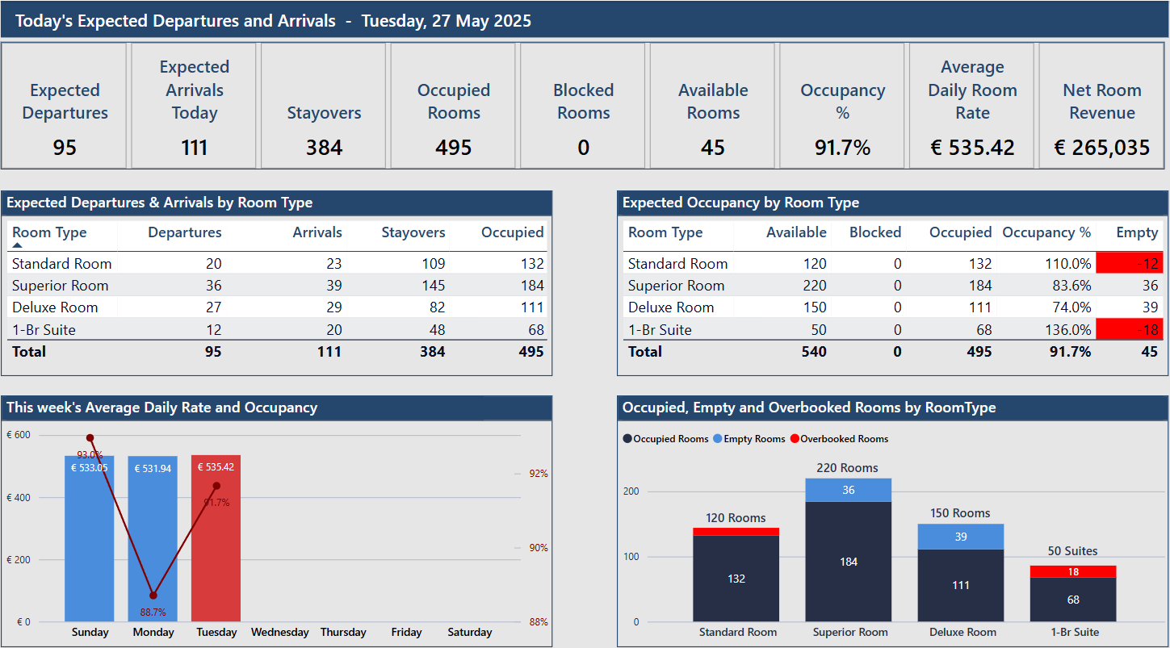

Slide 5
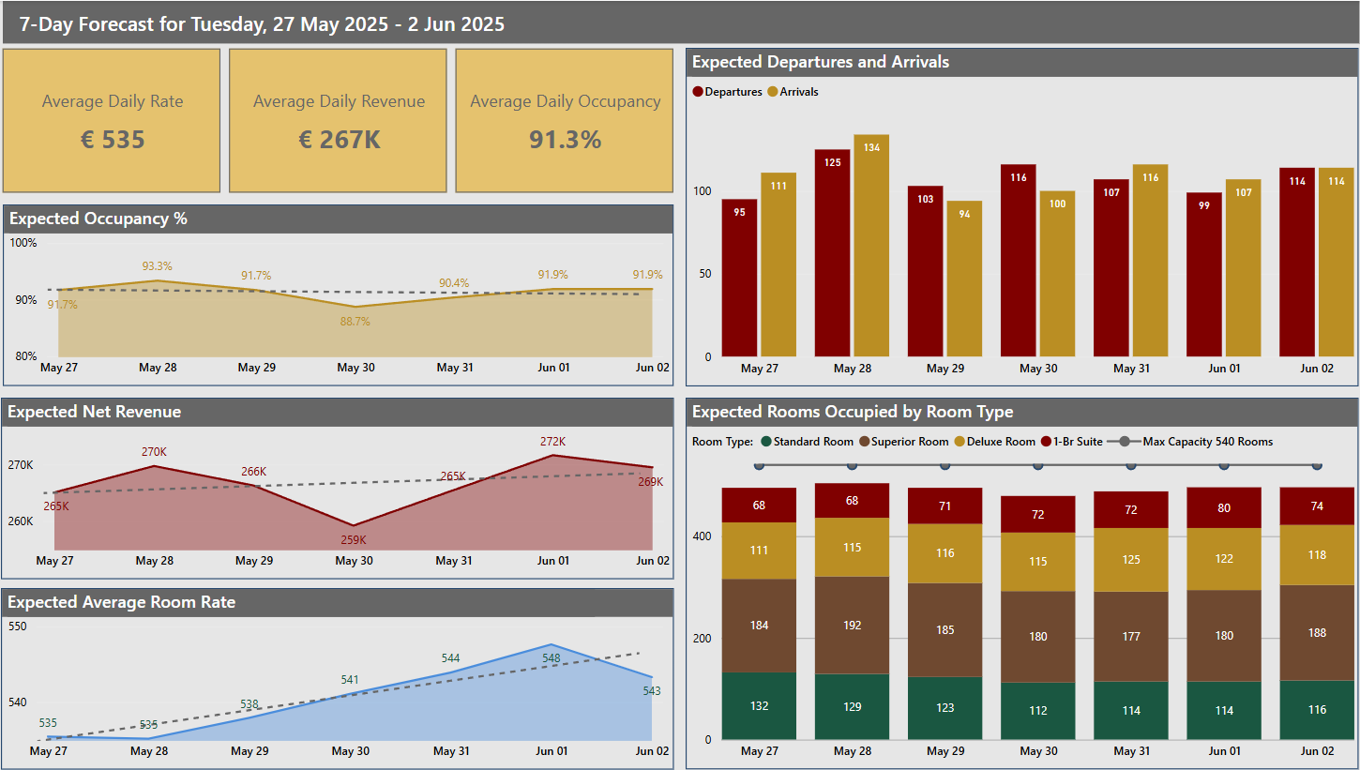

Slide 6
